Slide 1
Flip-Flops and
Types of flip flops
Presentation
on

Slide 2
Flip Flops
A Flip flop is sequential circuit capable of storing one .
A circuit that has two stable states is treated as a flip flop.
In the sequential logical circuit, the flip flop is the basic storage element.

Slide 3
Types of flip flops
SR Flip Flop
J-K Flip-flop
D Flip Flop
T Flip Flop

Slide 4
SR Flip Flop
The SR Flip Flop is the most common flip flop used in the digital system.
In SR flip flop, when the set input "S" is true, the output Y will be high, and Y' will be low.
The S-R flip flop is the simplest and easiest circuit to understand.

Slide 5
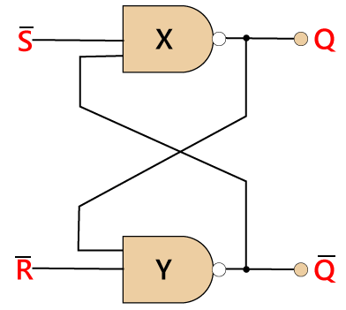
Circuit of SR Flip Flop

Slide 6
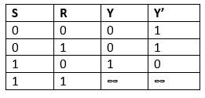
Truth Table: of SR Flip Flop

Slide 7
J-K Flip-flop
The J-K Flip-flop is used to remove the drawback of the S-R flip flop, i.e., undefined states.
The JK flip flop is formed by doing modification in the SR flip flop.
When S and R input is set to true, the SR flip flop gives an inaccurate result. But in the case of JK flip flop, it gives the correct output.

Slide 8
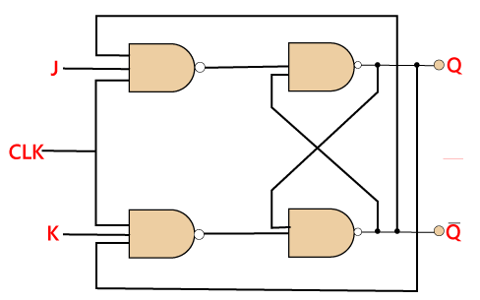
Circuit of JK Flip Flop

Slide 9
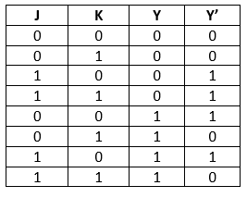
Truth Table: of JK Flip Flop

Slide 10
D Flip Flop
D flip flop is a widely used flip flop in digital systems.
It is the most important flip flop from other types.
The D Flip Flop is designed using gated SR Flip Flop with an inverter connected between inputs allowing for single input D.

Slide 11
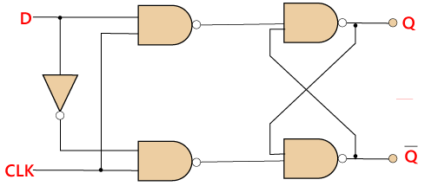
Circuit of D Flip Flop

Slide 12
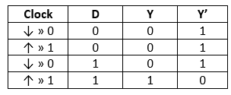
Truth Table: of D Flip Flop

Slide 13
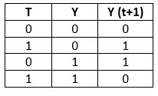
T flip flop
The T flip flop is also known as Toggle flip-flop.
The T flip flop is constructed by connecting both of the inputs of JK flip flop together as a single input.

Slide 14
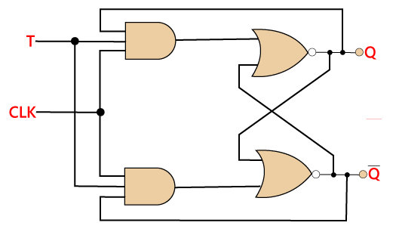
Circuit of T Flip Flop

Slide 15
Download ppt’s and handwritten notes
JP Web devolpers
Follow on instagram:-@jpwebdevelopers
Thank
you

